Slide 1
Educational Math Database
By Team Kaizen Blitz:
Brendan Ciccone, Ryan Woodward, Sarah Sparrow

Slide 2
Overview
1. Development Process
2. Text-Based Interface
3. Google BigQuery

Slide 3
1. Scenario
Website of students and volunteer teachers
Students complete math worksheets and submit them for marking
Teachers mark worksheets and are available on Skype

Slide 4
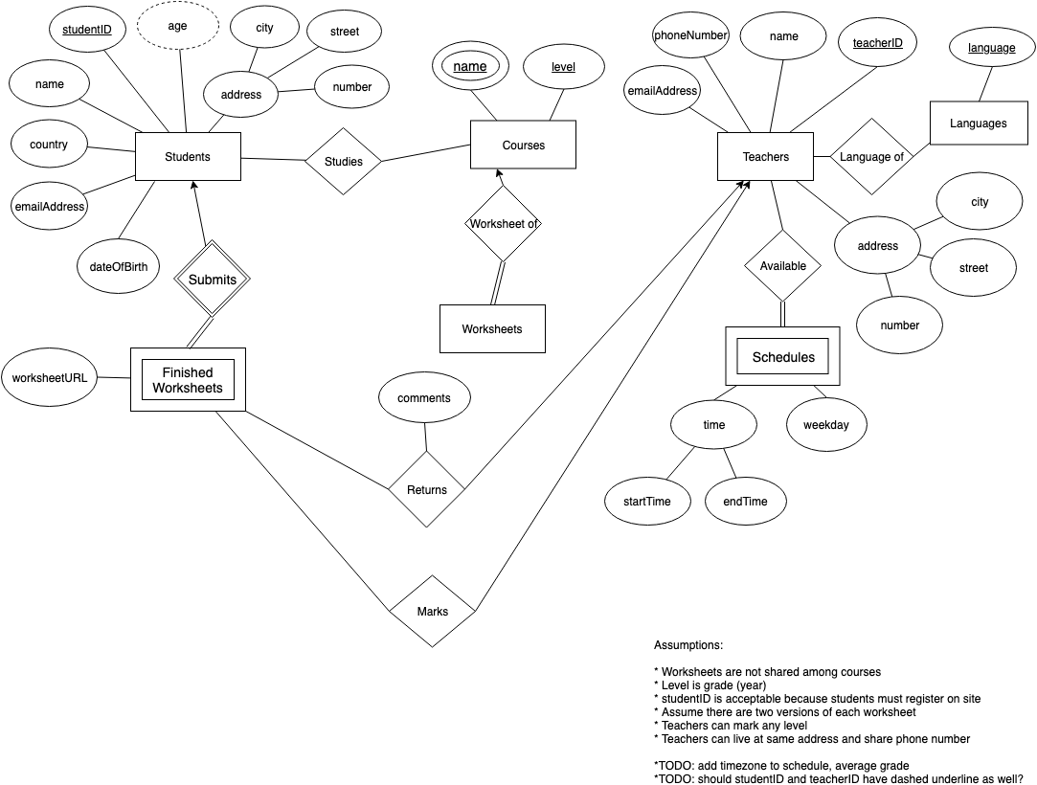
1. E/R Diagram
(Initial Version 1)

Slide 5
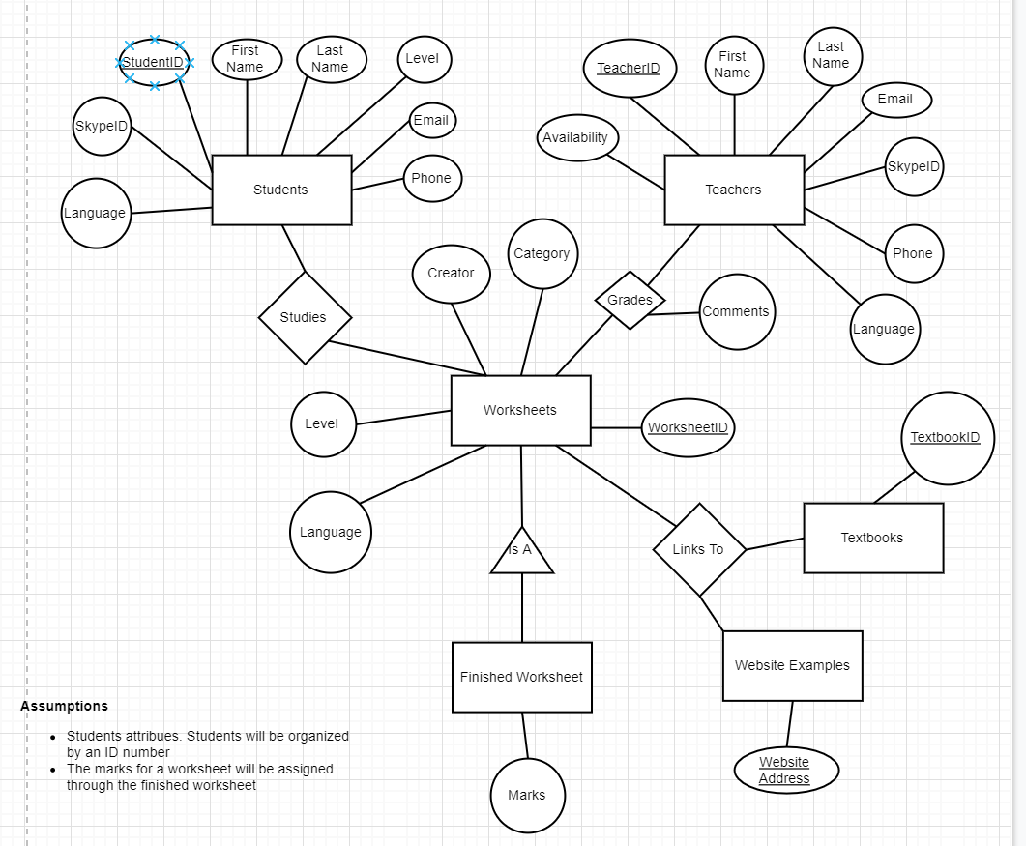
1. E/R Diagram
(Initial Version 2)

Slide 6
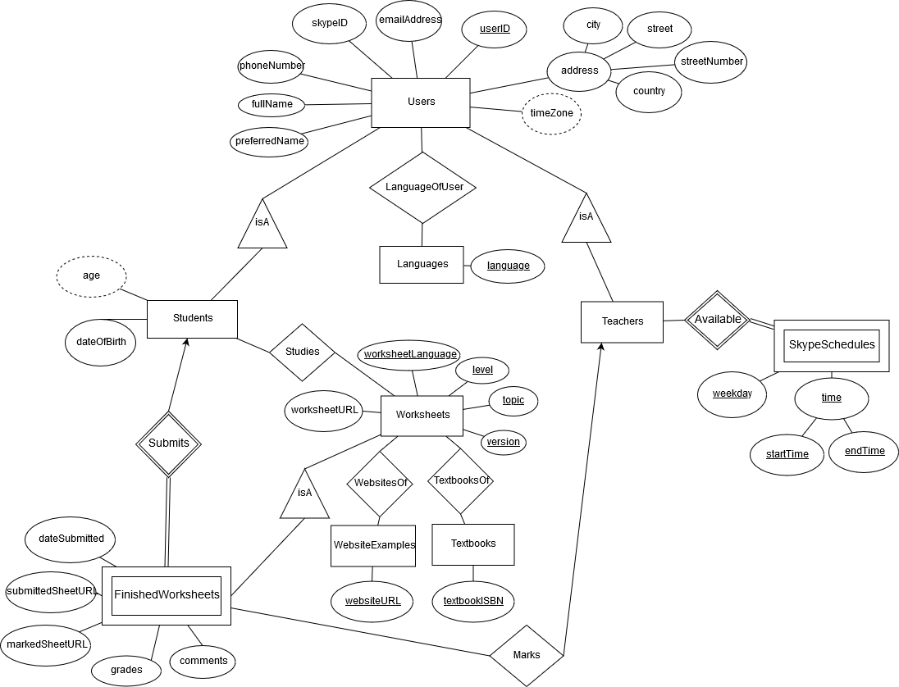
1. E/R Diagram

Slide 7
1. Database Schema
Users(userID, phoneNumber, fullName, preferredName, skypeID, emailAddress, city, street, streetNumber, country)
Languages(language)
LanguageOfUser(userID, language)
Students(userID, dateOfBirth)

Slide 8
1. Database Schema
Users(userID, phoneNumber, fullName, preferredName, skypeID, emailAddress, city, street, streetNumber, country)
Languages(language)
LanguageOfUser(userID, language)
Students(userID, dateOfBirth)
Teachers(userID)
SkypeSchedules(userID, weekday, startTime, endTime)
Marks(teacherUserID, level, topic, version, worksheetLanguage, studentUserID)

Slide 9
1. Database Schema
Users(userID, phoneNumber, fullName, preferredName, skypeID, emailAddress, city, street, streetNumber, country)
Languages(language)
LanguageOfUser(userID, language)
Students(userID, dateOfBirth)
Teachers(userID)
SkypeSchedules(userID, weekday, startTime, endTime)
Marks(teacherUserID, level, topic, version, worksheetLanguage, studentUserID)
Worksheets(level, topic, version, worksheetLanguage, worksheetURL)
FinishedWorksheets(userID, level, topic, version, worksheetLanguage, dateSubmitted, submittedSheetURL, markedSheetURL, grades, comments)
WebsitesOf(websiteURL, level, topic, version, worksheetLanguage)
TextbooksOf(textbookISBN, level, topic, version, worksheetLanguage)
WebsiteExamples(websiteURL)
Textbooks(textbookISBN)

Slide 10
1. Development Issues
Lack of use cases -> no passwords
Users(userID, phoneNumber, fullName, preferredName, skypeID, emailAddress, city, street, streetNumber, country)

Slide 11
1. Development Issues
Lack of use cases -> no passwords
Users(userID, phoneNumber, fullName, preferredName, skypeID, emailAddress, city, street, streetNumber, country)
Creating primary key for worksheets
Worksheets(level, topic, version, worksheetLanguage, worksheetURL)

Slide 12
1. Development Issues
Owner of Implementation the Database
When implementing the database only one person could be the ‘owner’ at any particular time. Even when the database was built in the team’ datastore

Slide 13
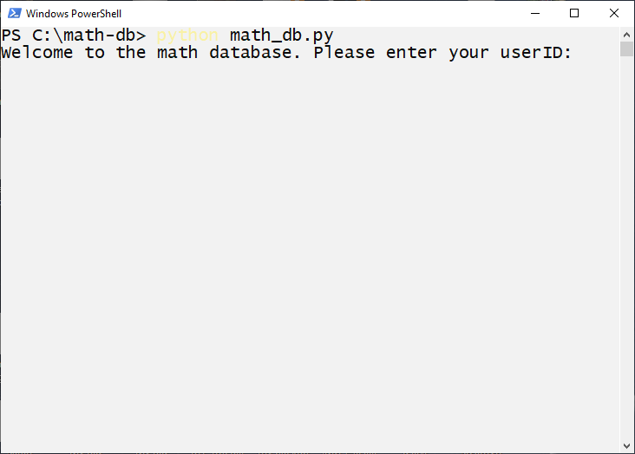
2. Text-Based Interface

Slide 14
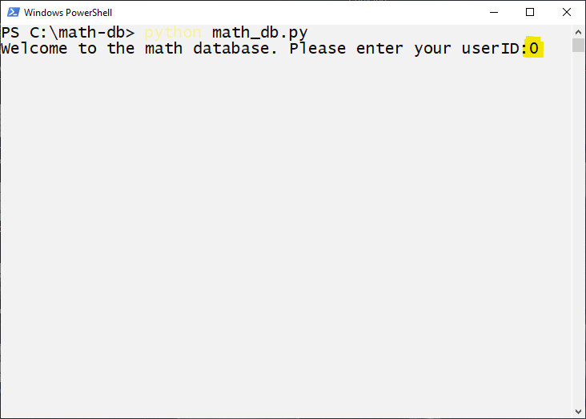

Slide 15
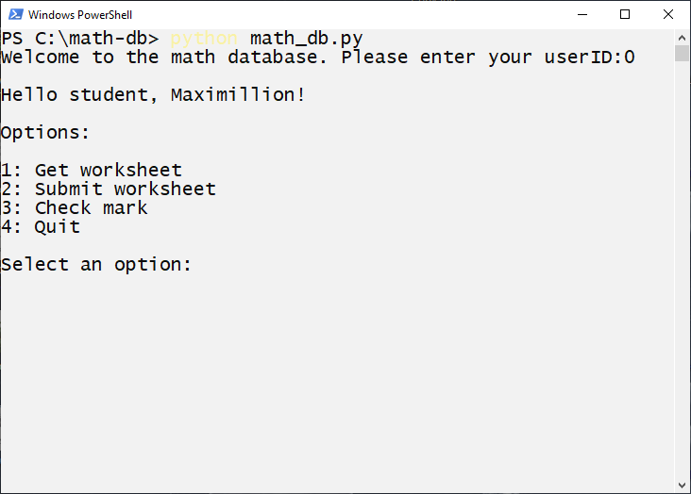

Slide 16
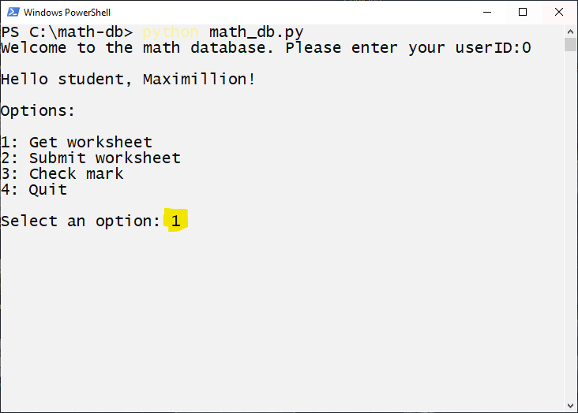

Slide 17
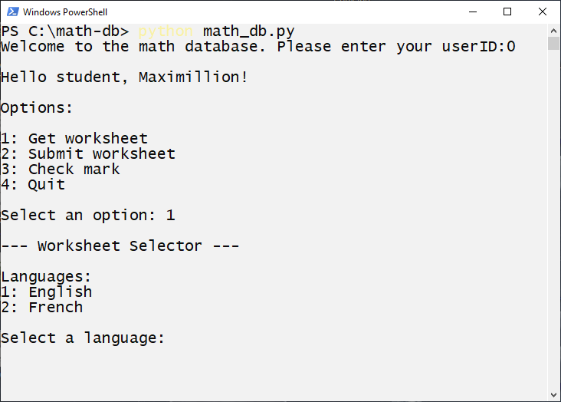

Slide 18
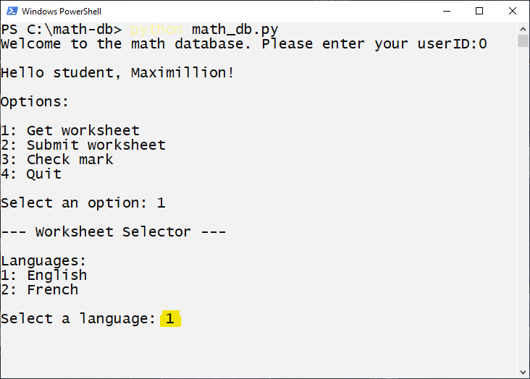

Slide 19
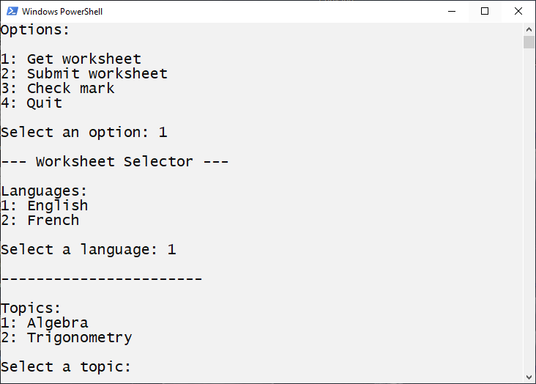

Slide 20
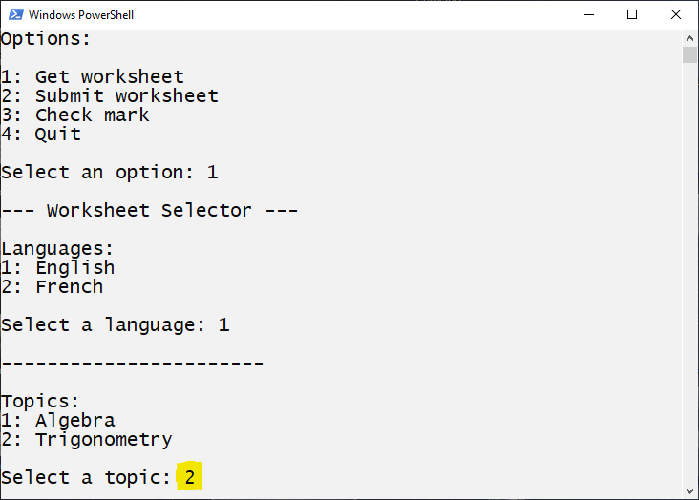

Slide 21
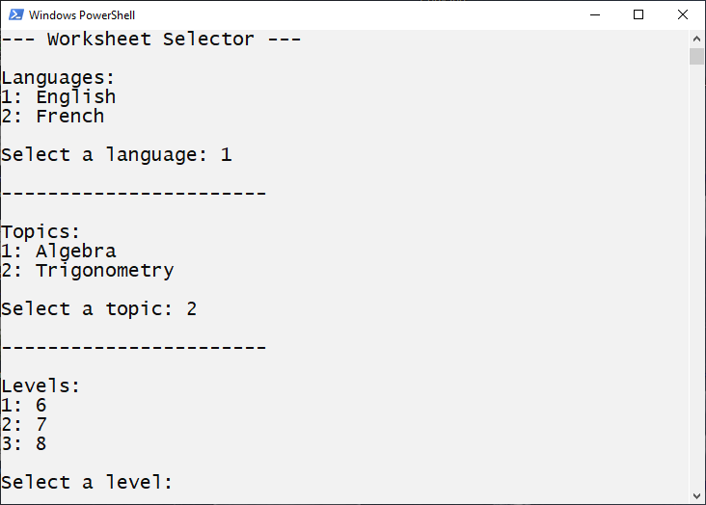

Slide 22
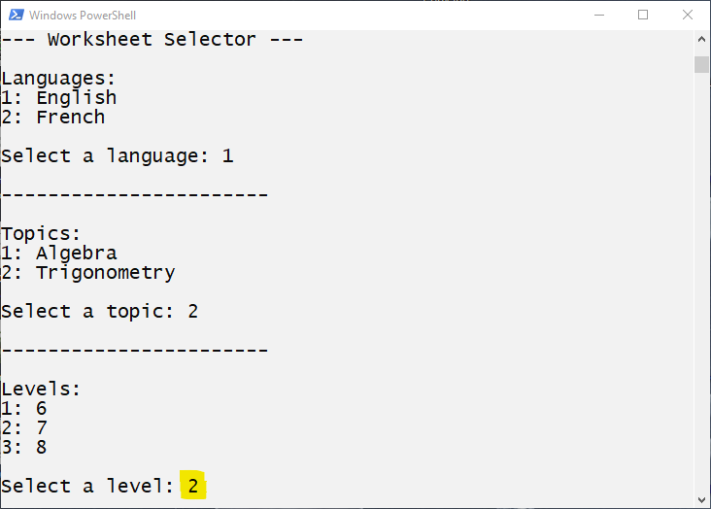

Slide 23
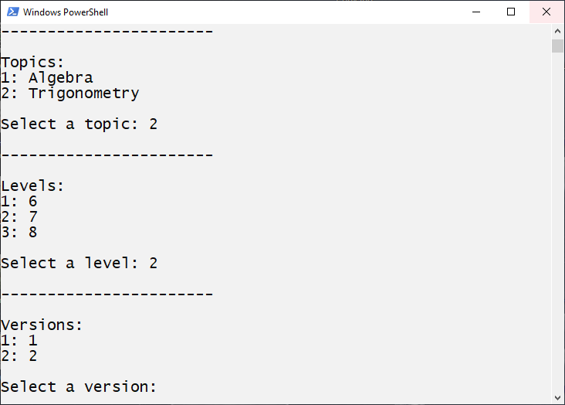

Slide 24
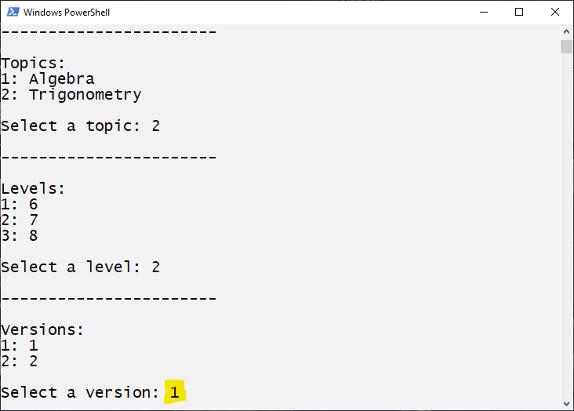

Slide 25
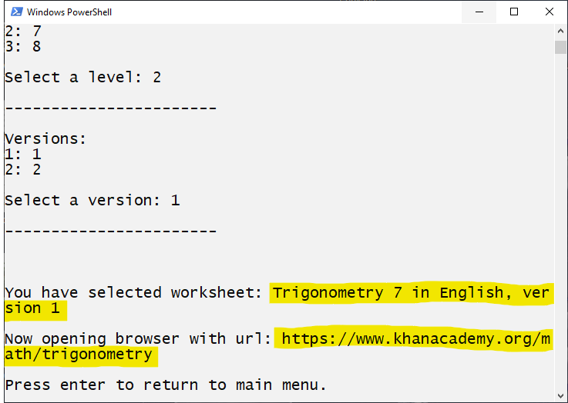

Slide 26
3. Google BigQuery
3.1 Wikipedia Pageviews Dataset
3.2 Google Patents Dataset
3.3 Github Repositories Dataset

Slide 27
3.1 Wikipedia: What pages with titles like “Battle of” were viewed the most between Nov 1-13 in 2018?
SELECT DISTINCT(A.title) as title, SUM(A.views) as views
FROM `bigquery-public-data.wikipedia.pageviews_2018` A
WHERE A.title LIKE 'Battle_of_%' AND DATE(A.datehour) >= "2018-11-01"AND DATE(A.datehour) <= "2018-11-13"
GROUP BY title
ORDER BY views DESC
LIMIT 10;

Slide 28
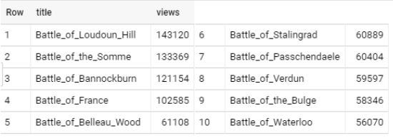
3.1 Wikipedia: Pageviews with titles like “Battle of”...
SELECT DISTINCT(A.title) as title, SUM(A.views) as views
FROM `bigquery-public-data.wikipedia.pageviews_2018` A
WHERE A.title LIKE 'Battle_of_%' AND DATE(A.datehour) >= "2018-11-01"AND DATE(A.datehour) <= "2018-11-13"
GROUP BY title
ORDER BY views DESC
LIMIT 10;

Slide 29
3.2 Google Patents: How many patents have been filed?
SELECT COUNT(publication_number)
FROM ‘patents-public-data.patens.publications;

Slide 30
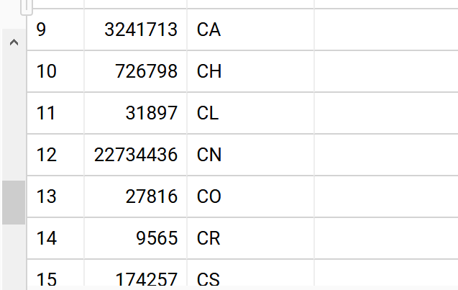
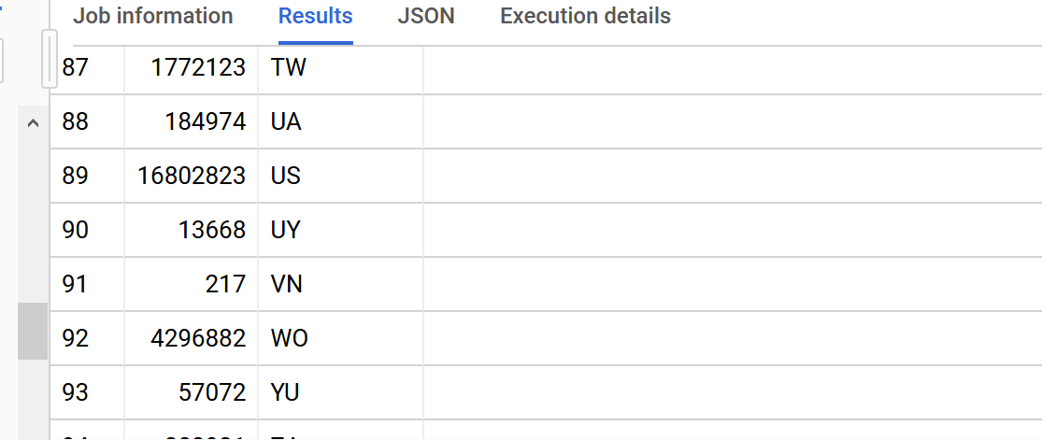
3.2 Google Patents: How many patents has each country filed? With a minimum of 100 patents filed
SELECT COUNT(*) AS cnt, country_code
FROM ‘patents-public-data.patents.publications
GROUP BY country_code
HAVING cnt > 100
ORDER BY country_code;

Slide 31
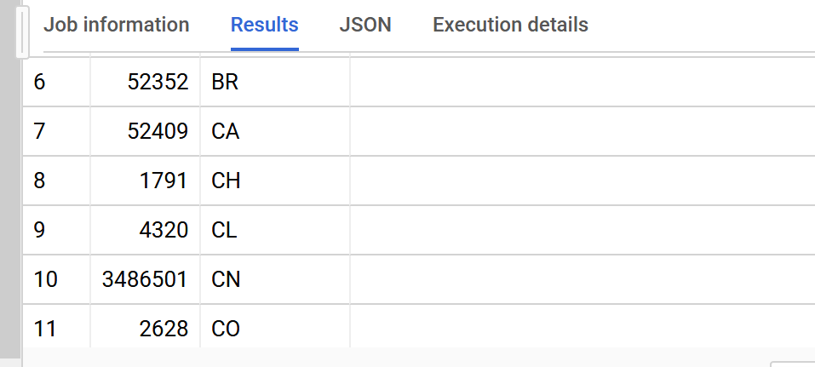
3.3 Google Patents: How many patents did each country file in the year 2018?
SELECT COUNT(*) AS cnt, country_code
FROM ‘patents-public-data.patents.publications
WHERE publication_date <= 20180101 AND publication_date <= 20181231
GROUP BY country_code HAVING cnt > 100
ORDER BY country_code;

Slide 32
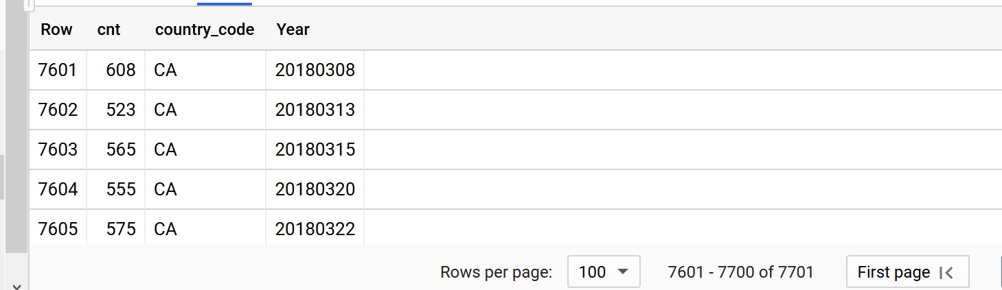
3.4 Google Patents: What is the number of patents Canada put out each recorded day?
SELECT COUNT(*) AS cnt, country_code
FROM ‘patents-public-data.patents.publications
WHERE country_code = ‘CA’
GROUP BY country_code, publication_date
HAVING cnt > 100
ORDER BY publication_date;

Slide 33
3.5 Github Repos: What repos contained C files?
SELECT repo_name, language
FROM `bigquery-public-data.github_repos.languages`
CROSS JOIN UNNEST (language) AS single_language
WHERE single_language.name = “C”

Slide 34
3.5 Github Repos: What repos contained C files?
SELECT repo_name, language
FROM `bigquery-public-data.github_repos.languages`
CROSS JOIN UNNEST (language) AS single_language
WHERE single_language.name = “C”

Slide 35
3.5 Github Repos: What repos contained C files?
SELECT repo_name, language
FROM `bigquery-public-data.github_repos.languages`
CROSS JOIN UNNEST (language) AS single_language
WHERE single_language.name = “C”

Slide 36
3.5 Github Repos: What repos contained C files?
SELECT repo_name, language
FROM `bigquery-public-data.github_repos.languages`
CROSS JOIN UNNEST (language) AS single_language
WHERE single_language.name = “C”

Slide 37
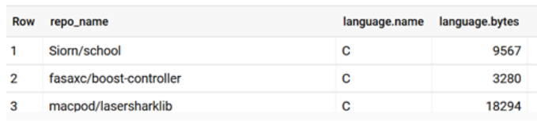
3.5 Github Repos: What repos contained C files?
SELECT repo_name, language
FROM `bigquery-public-data.github_repos.languages`
CROSS JOIN UNNEST (language) AS single_language
WHERE single_language.name = “C”

Slide 38
3.6 Github Repos: Which repo was the largest?
SELECT repo_name
FROM `bigquery-public-data.github_repos.files`
WHERE id IN (SELECT R1.id
FROM `bigquery-public-data.github_repos.contents` R1
WHERE R1.size = (SELECT MAX(R2.size)
FROM `bigquery-public-data.github_repos.contents` R2

Slide 39
3.6 Github Repos: Which repo was the largest?
SELECT repo_name
FROM `bigquery-public-data.github_repos.files`
WHERE id IN (SELECT R1.id
FROM `bigquery-public-data.github_repos.contents` R1
WHERE R1.size = (SELECT MAX(R2.size)
FROM `bigquery-public-data.github_repos.contents` R2

Slide 40
3.6 Github Repos: Which repo was the largest?
SELECT repo_name
FROM `bigquery-public-data.github_repos.files`
WHERE id IN (SELECT R1.id
FROM `bigquery-public-data.github_repos.contents` R1
WHERE R1.size = (SELECT MAX(R2.size)
FROM `bigquery-public-data.github_repos.contents` R2

Slide 41

3.6 Github Repos: Which repo was the largest?
SELECT repo_name
FROM `bigquery-public-data.github_repos.files`
WHERE id IN (SELECT R1.id
FROM `bigquery-public-data.github_repos.contents` R1
WHERE R1.size = (SELECT MAX(R2.size)
FROM `bigquery-public-data.github_repos.contents` R2

Slide 42
Summary
1. Development Process
2. Text-Based Interface
3. Google BigQuery

Slide 43
Summary
1. Development Process
2. Text-Based Interface
3. Google BigQuery
Any Questions?

Slide 44
Thank you

